Slide 1
Machine learning
ENG . Mahmoud ragab

Slide 2
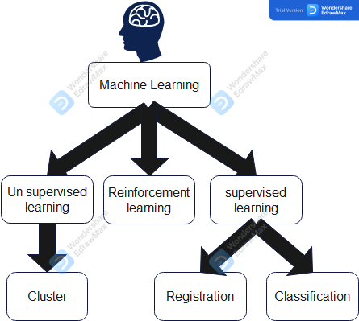

Slide 3
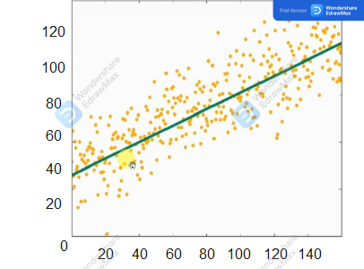
regression
Idea:- I have related data and I want to know the values of new data

Slide 4
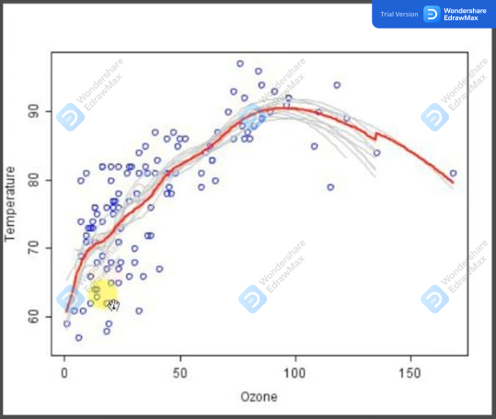
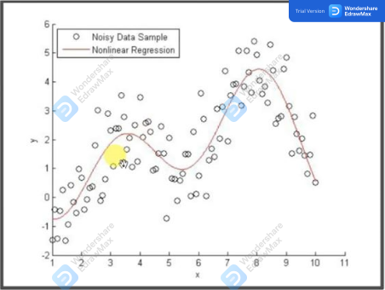

Slide 5
applications:-
* House prices
* Stock prices on the stock exchange
* weather condition
* sugar level in blood

Slide 6

classification
Idea:- I have data related to each other and we want to divide it into similar groups

Slide 7
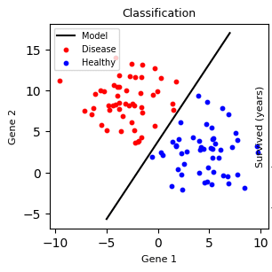
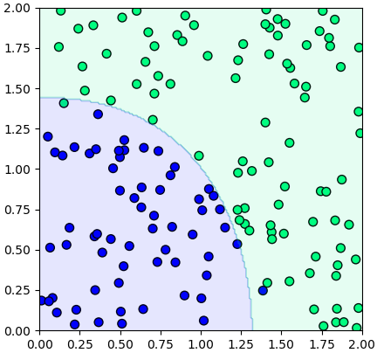

Slide 8
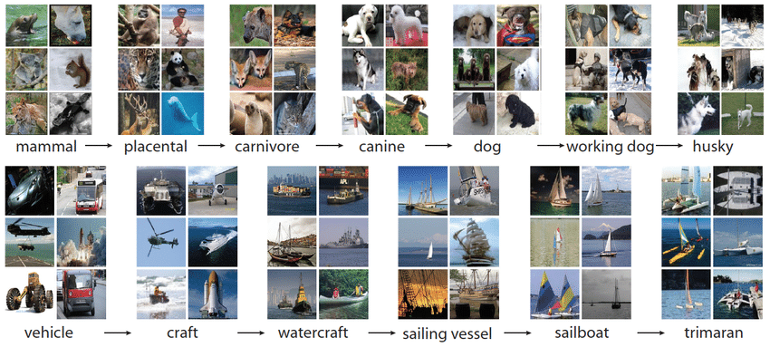

Slide 9
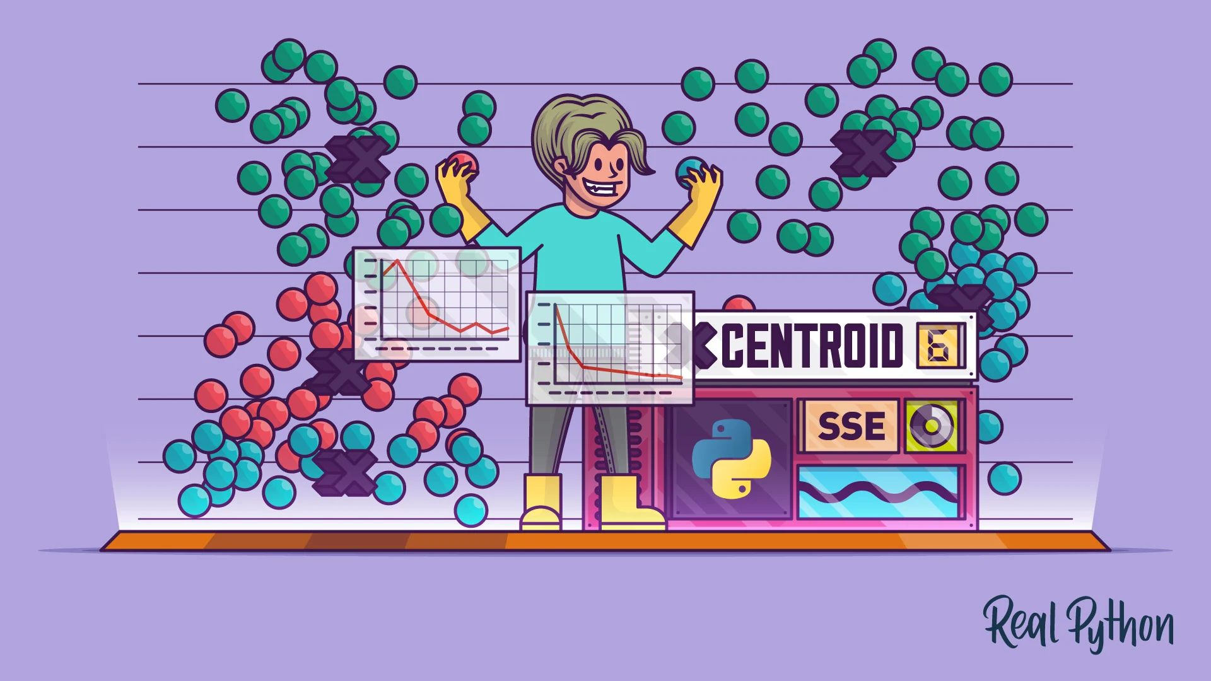
Un supervised learning )Cluster(
idea :-
I have data and I do not have information about it, and I want to divide it into similar groups

Slide 10
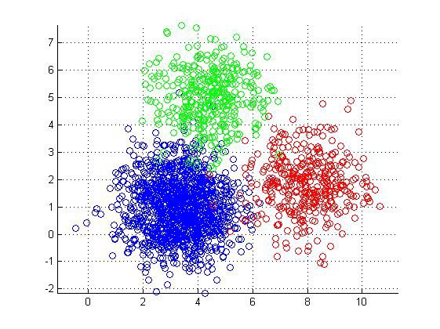
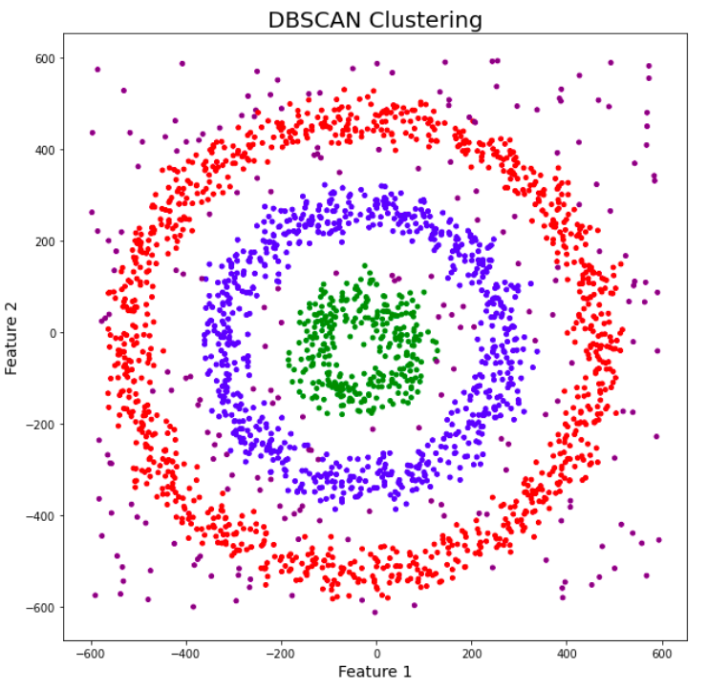

Slide 11
applications:-
* Divide and categorize movies
* Recommend products for you on shopping sites
* Suggest your friends on Facebook
* Filter the news for you according to your inclinations

Slide 12


What programs will we use?
Anaconda program : https://www.anaconda.com/download/

Slide 13
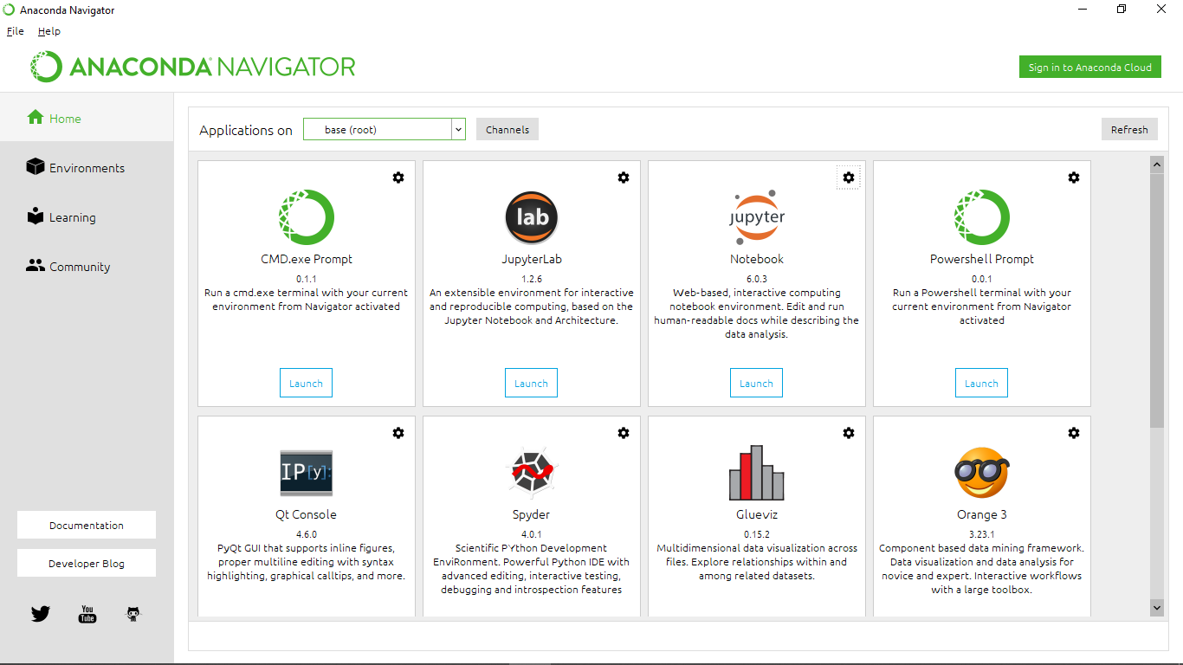
how to operate?

Slide 14
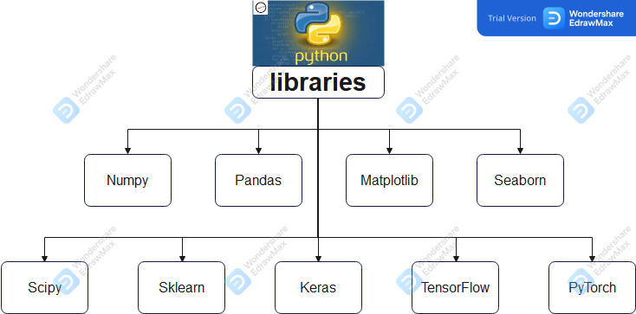
What libraries will we need?

Slide 15
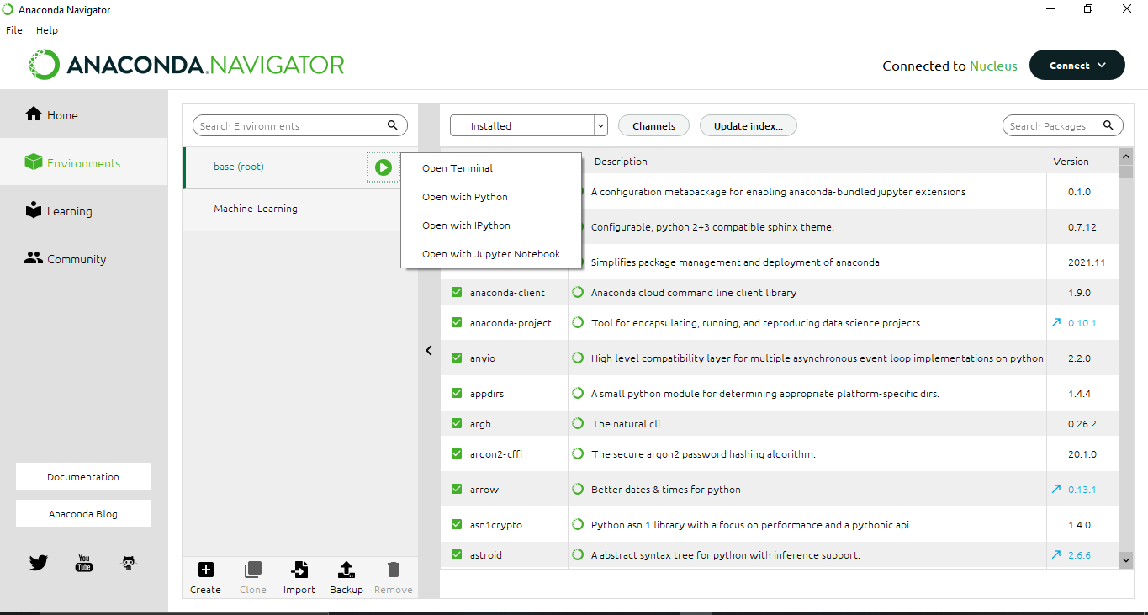
How to install this libraries?
2
3
1

Slide 16
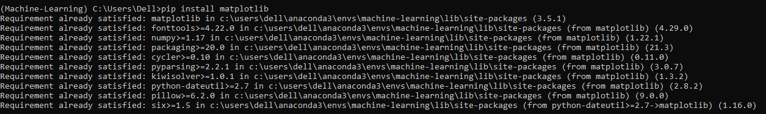
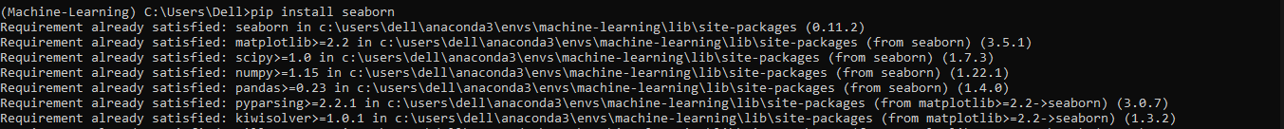
Numpy
Pandas
Matplotlib
Seaborn

Slide 17
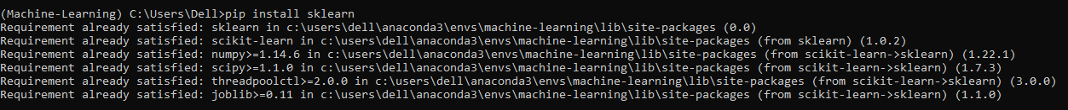
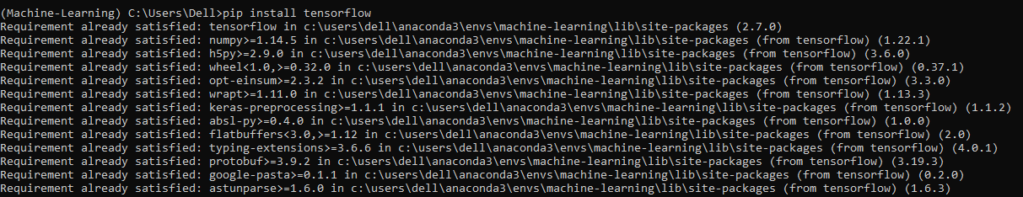
Sklearn
Scipy
Keras
TensorFlow

Slide 18
any questions ?

